Slide 1
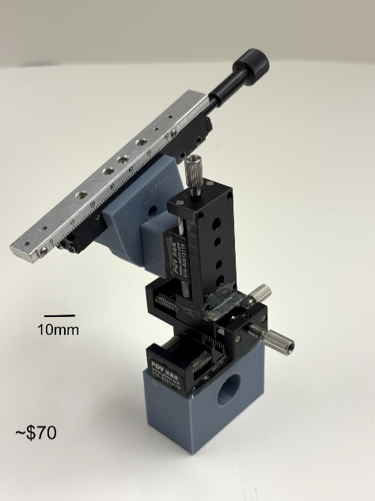
DIY – Building the “Tiny” micromanipulator

Slide 2
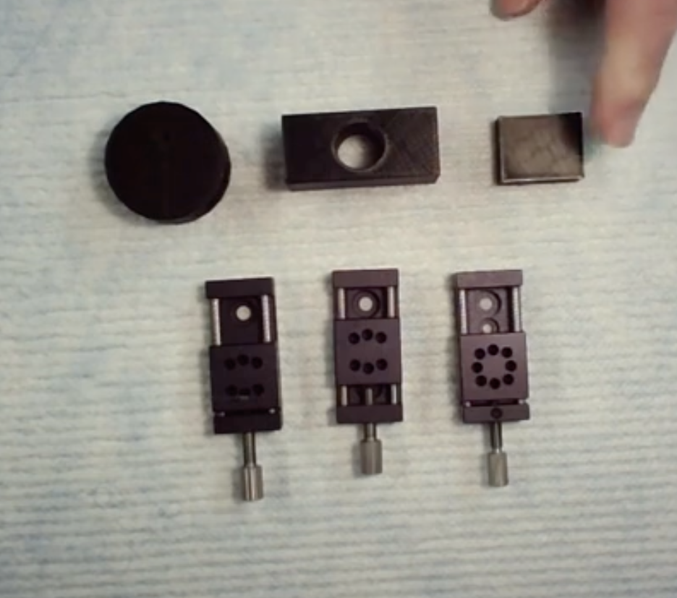
The Parts
3 - 3D printed parts
-print at 80% infill
3 small linear stages
https://www.alibaba.com/product-detail/PT-SD10-Miniature-Manual-Linear-Stage_60537789251.html

Slide 3
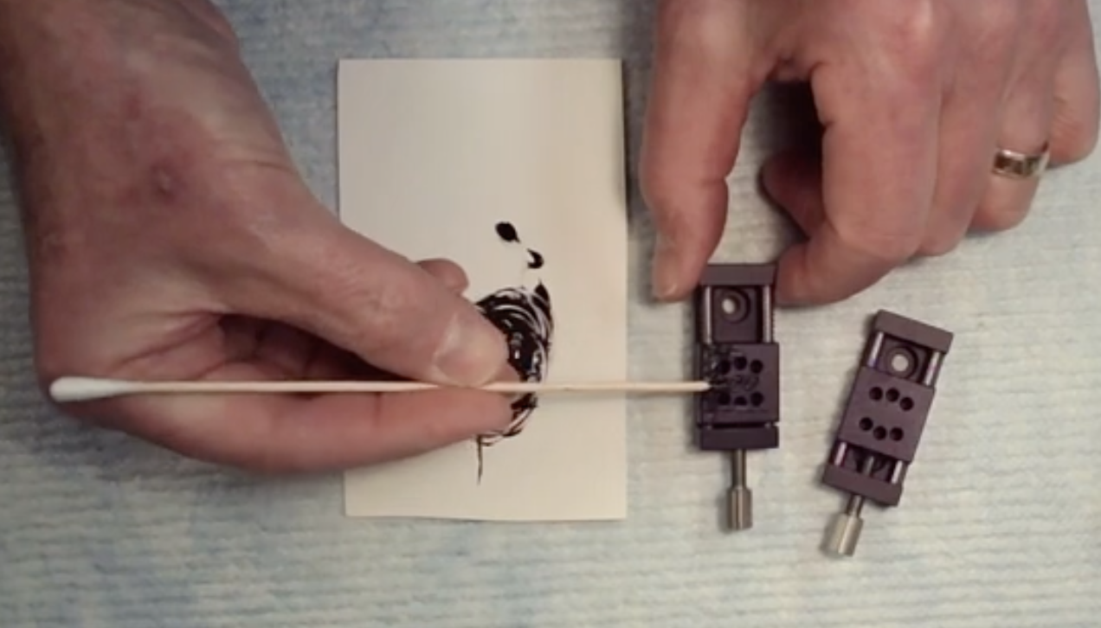
4) Butter epoxy onto the small top plate of one stage.
- do not get much epoxy into the six little holes

Slide 4
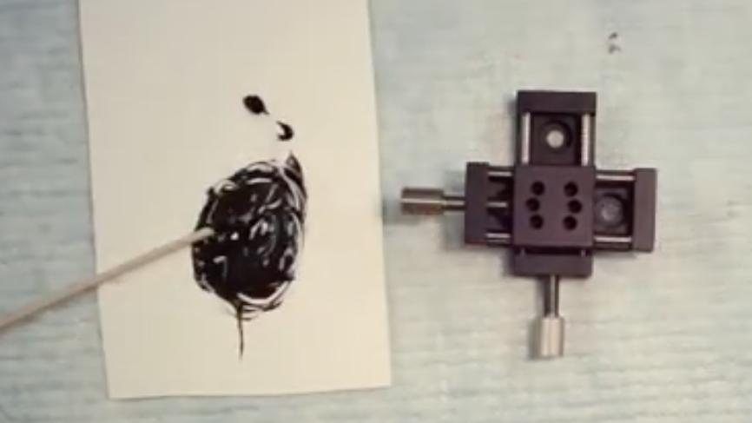
5) Place a second linear stage onto the small top plate of the stage you just buttered
ORIENTED 90 DEGREES TO LOWER STAGE

Slide 5
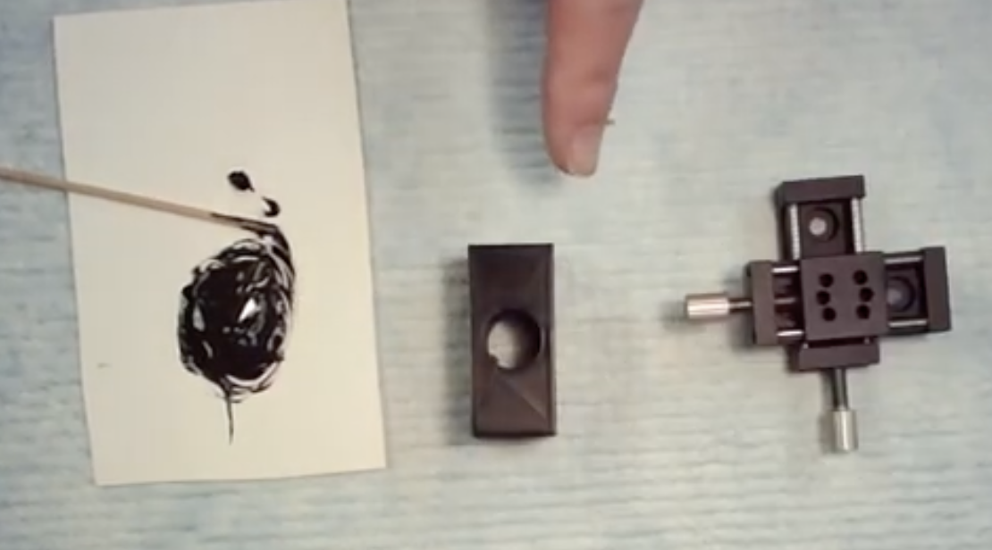
2) Butter epoxy onto non-hole side of 3D printed base
see blue arrow
1) Mix 2 part, 5-min epoxy
3) Place bottom of one linear stage onto epoxy

Slide 6
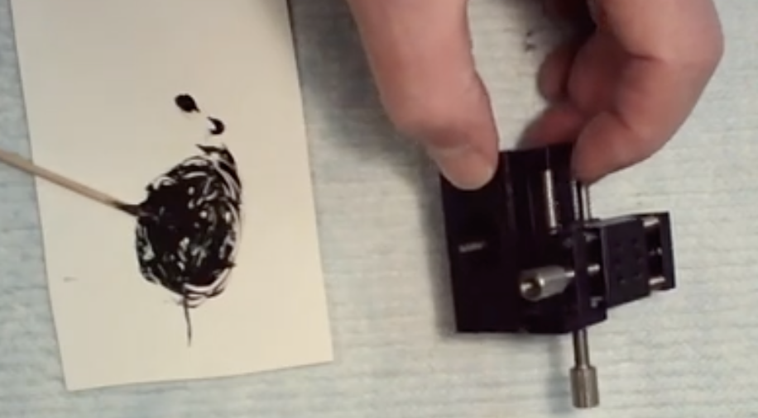
It should now look like this – PUT ASIDE AND LET EPOXY DRY

Slide 7
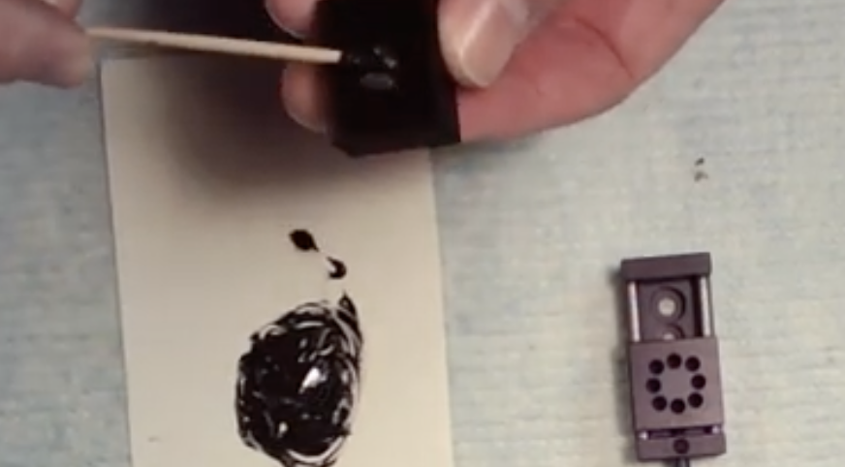
7) Butter epoxy on the back of the small 3D printed square.

Slide 8
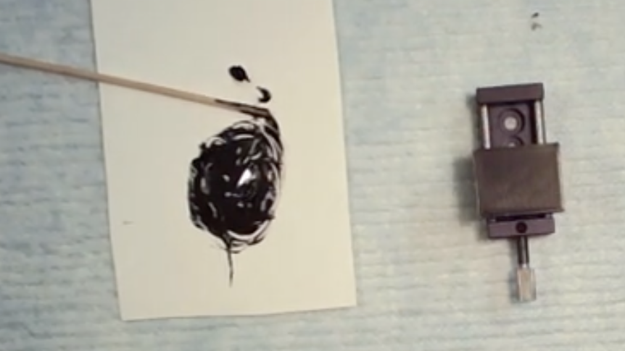
8). Place the epoxy side of the square down onto the third moveable square of the linear stage as shown below. Try not to get lots of epoxy into the six holes on the stage.
Set aside to dry

Slide 9
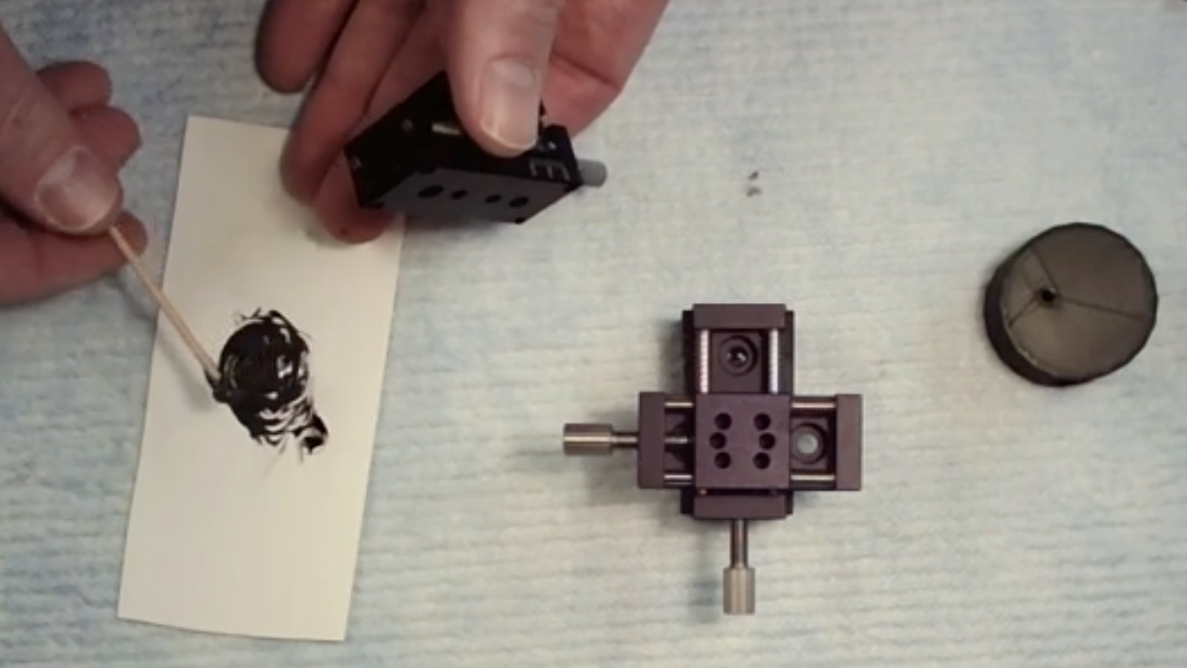
9) When all parts are cured (~ 15-20 minutes for 5-minute epoxy) butter fresh epoxy onto the END of the stage with the square 3D printed part (blue arrow) – and place it vertically onto the x-y stage (red arrow).

Slide 10
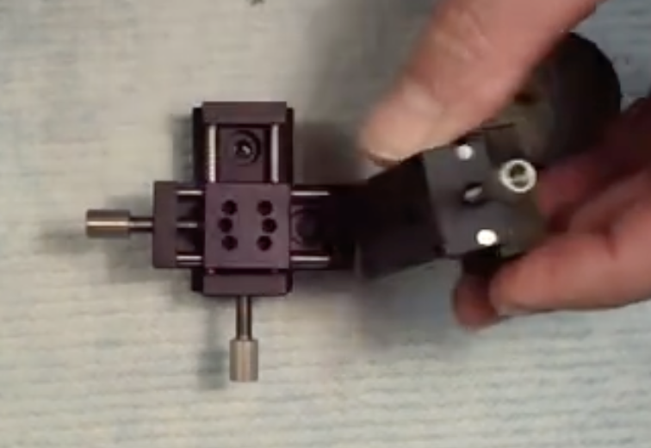
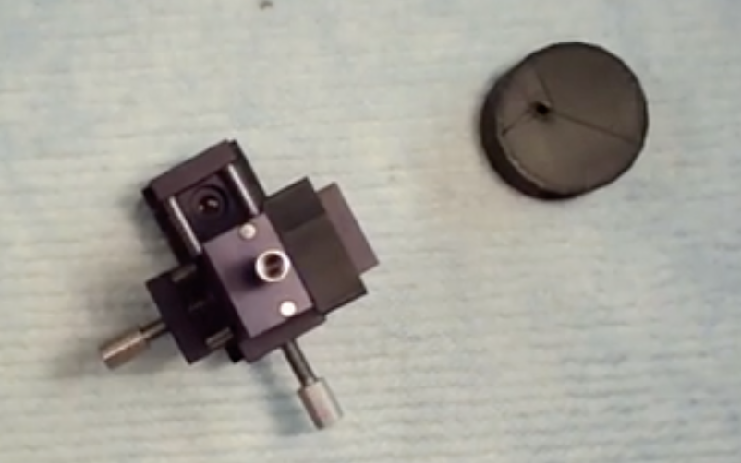
You should now have a 3-axis manipulator
Let it dry fully

Slide 11
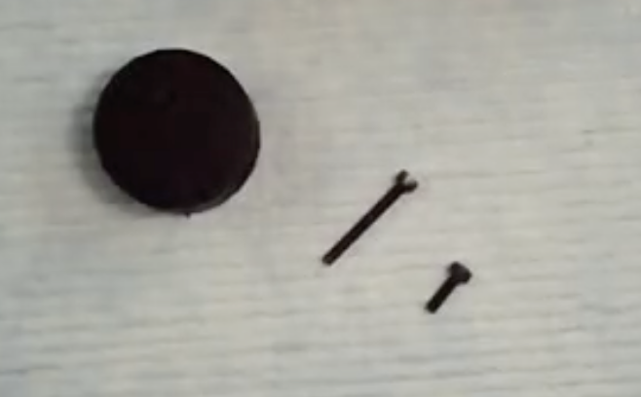
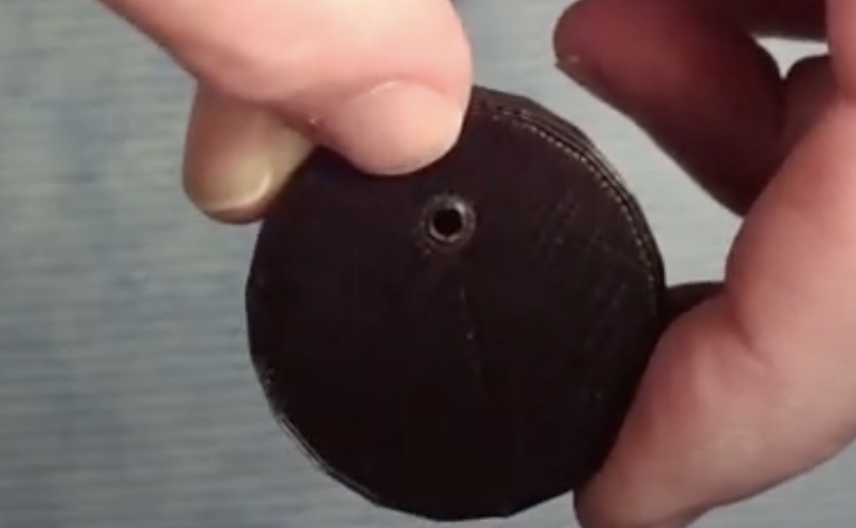
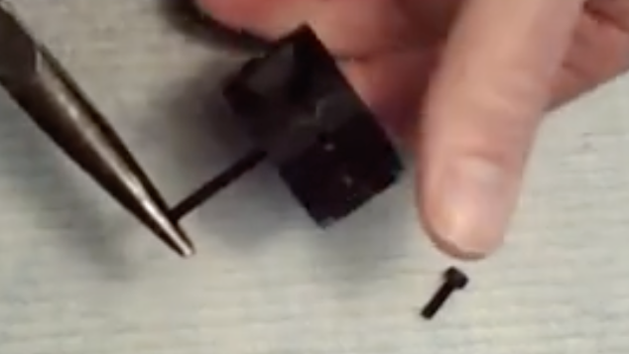
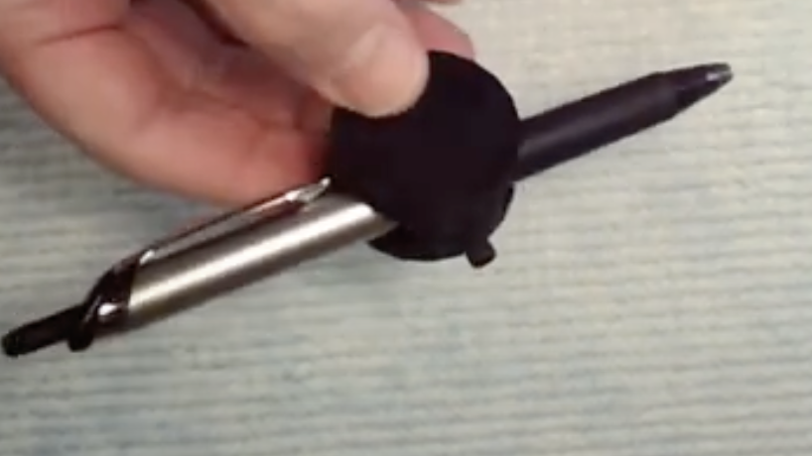
10) The circular 3D printed part is the Probe Holder. There are 2 screws needed to mount the holder to the 3-axis manipulator.
11) The long screw gets threaded onto the small 3mm hole in the side of the probe holder - arrow
12) Screw in the screw until it just protrudes from the other side
13) Screw in the smaller screw that will hold the probe into the side of the circular part as shown above

Slide 12
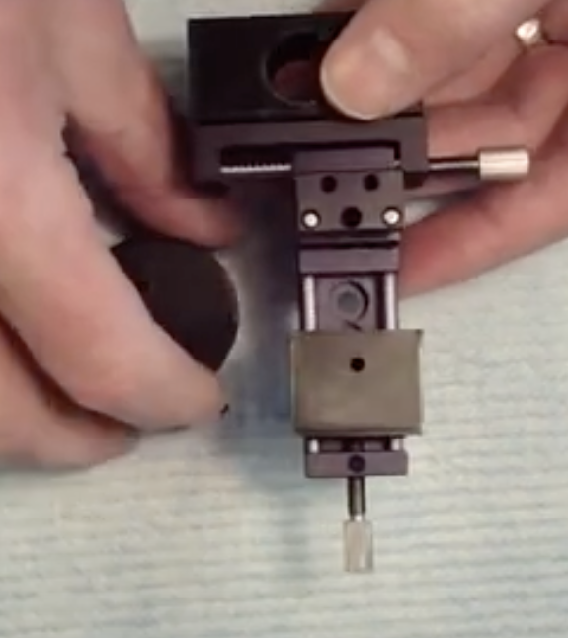
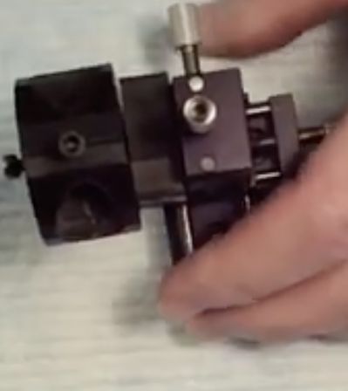
Finish mounting the probe holder to the 3-axis stage by further screwing in the long screw into the hole on the square 3D printed part - arrow

Slide 13
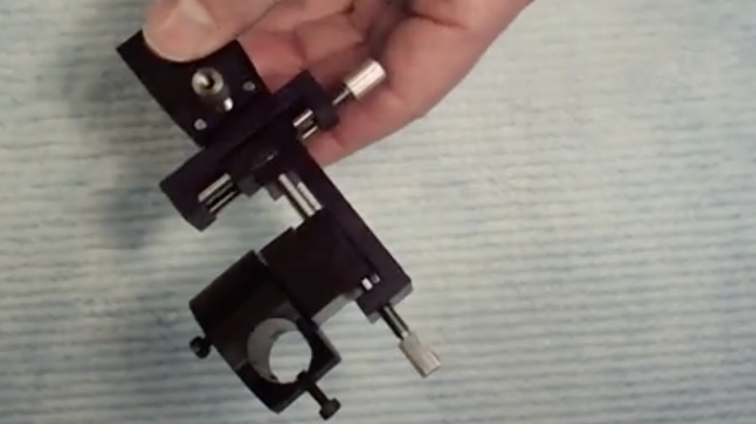
Finished 3-axis manipulator

Slide 14
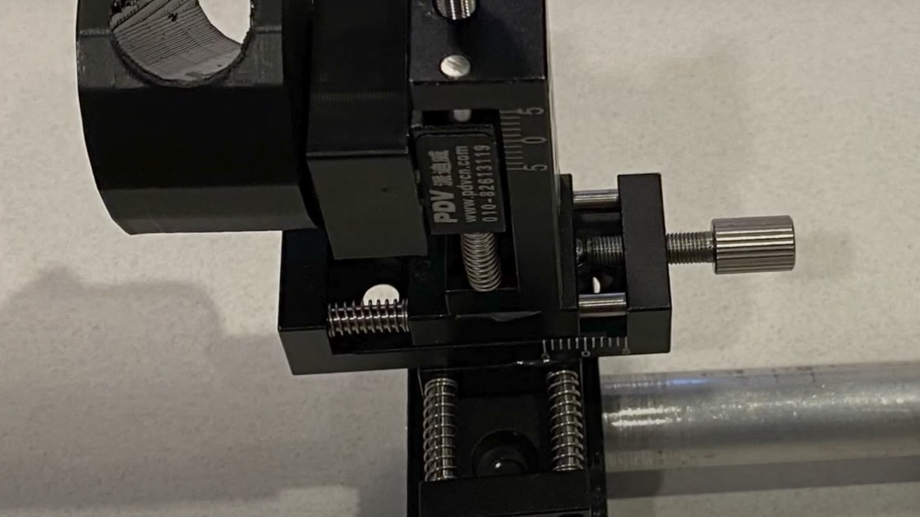
Optional – epoxy the ½ inch diameter rod into the hole in the base

